Slide 1
Computer Organization & Assembly Language (CSC-205)
Lecture 1: Orientation & Introduction

Slide 2
Course Orientation

Slide 3
Course Objective
Introduction to the internal organization of computer systems, including the relationship between
Computer hardware
It’s native instruction set
Implementation of high level languages on that machine
Practical work using the x86 based Microsoft Macro Assembler

Slide 4
Learning Outcome
Understanding the process that occurs when high level code is translated into machine code
A better understanding of how code actually works
Ability to program using Intel’s x86 assembly language

Slide 5
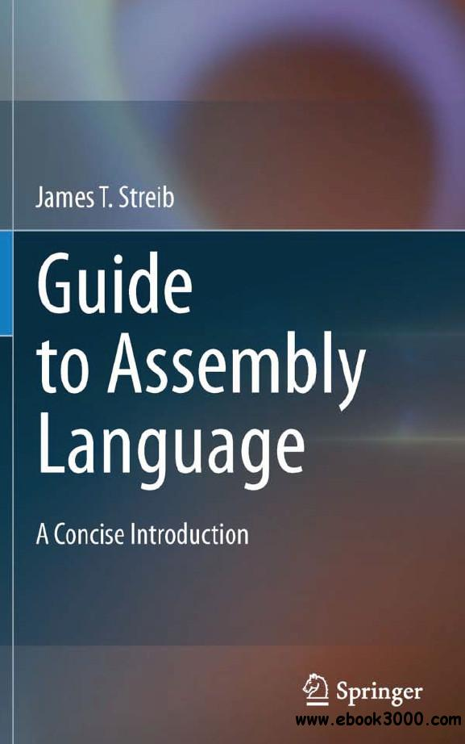
Text Book

Slide 6
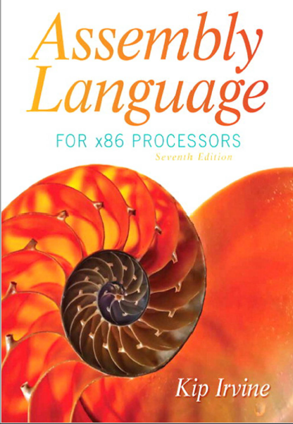
Reference Book

Slide 7
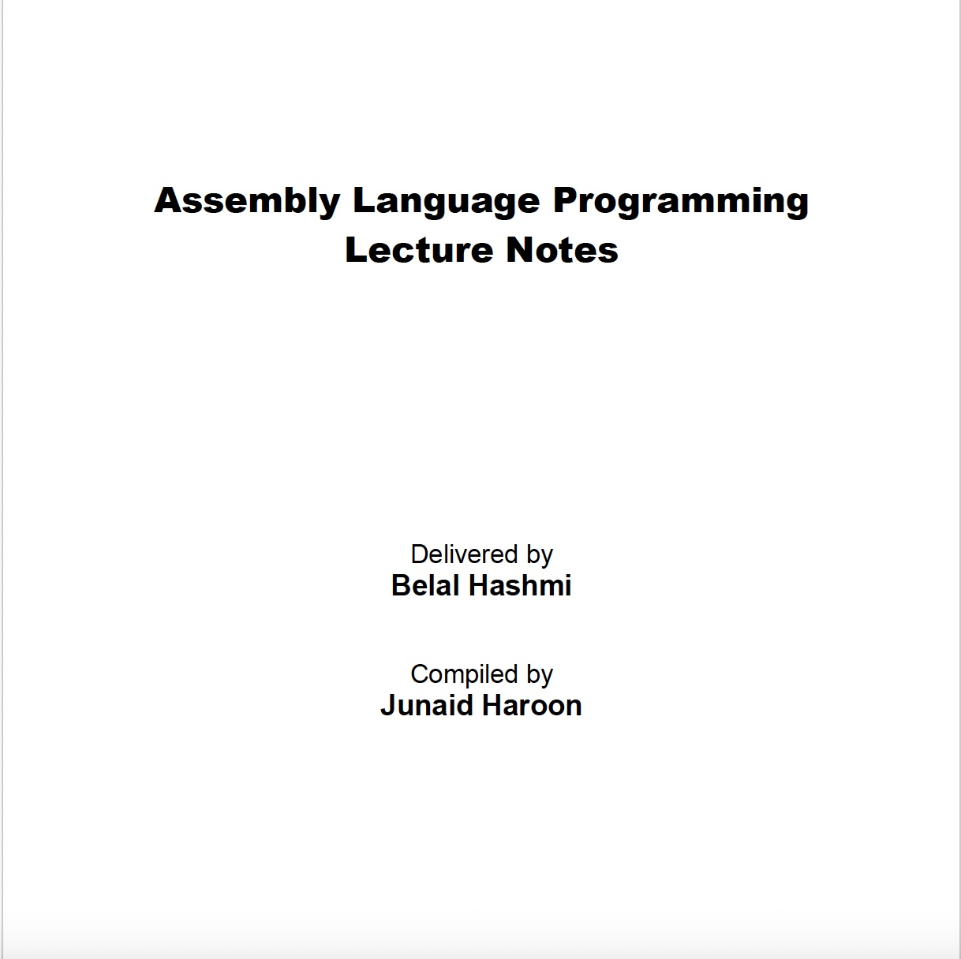
Reference Book

Slide 8
Course Format
2 credit hour course
2 lectures in a week

Slide 9
Lectures | Labs
Intro to course A sample first program | Lab: A sample first program
Binary, hexadecimal, logic and arithmetic revision | Problem set: Conversion practice
Variable declaration Registers Data movement | Lab: Inspecting register and variable values
Character data Errors | Lab: A complete program
Input and output | Lab: A complete program using input, data transfer and output

Slide 10
Lectures | Labs
Arithmetic instructions Addition & subtraction Multiplication & division Unary operators | Lab: Implementing I/O and arithmetic
Selection structures High level directives | Lab: Selection structures
Iteration structures | Lab: Power function implementation
Logic instructions (shift, rotate) Stacks | Lab: Simulating an OCR machine
Procedures and macros | Lab: Implementing a macro calculator

Slide 11
Lectures | Labs
Arrays Declaration Indexing | Lab: Selection sort
Strings | Lab: An array of strings
Interrupts | Lab: Using interrupts
Selected machine language instructions | Lab: Using machine language instructions
Recap and revision | Lab: Practice exercises

Slide 12
Division of Marks
Total | 100
Assignments | 10
Quizes (4) | 15
Midterm Test | 25
Project | 10
Final Exam | 40

Slide 13
Google Classroom code: p5vf35j
For text books, slides, assignments, course updates etc.

Slide 14
Administrative Info
Be careful with attendance (for both lectures and labs)
Keep a record of all your assessment till your grade has been finalized
No Makeup for an announced quiz and assignments
All activities assigned in class or for home are marked and will contribute to your grade
Don’ make requests for attendance via email
No tolerance for plagiarism
Late assignments will not be accepted

Slide 15
Introduction

Slide 16
Importance of Assembly Language
Practically, the need for assembly language programming has decreased
However, the need to understand it has not decreased

Slide 17
Importance of Assembly Language
Some practical programming experience needed to understand the language
Some high level languages include low level features, but sometimes using assembly language is efficient in terms of speed and memory
Like programming in machine language, but easier – helps gain insight into computer organization and architecture
Builds understanding of high level language implementations and compiler construction concepts

Slide 18
What is the difference between a High Level Language and a Low Level Language?

Slide 19
High Level Languages
High-level languages are human-friendly. They are, thus, very easy to understand and learn by any programmer. C, FORTRAN, Java
Closer to natural languages
Make programs easier to read and write

Slide 20
Low Level Languages
Closer to machines
High level to low level language
→ One to many relationship
Language translators (compilers, interpreters) convert one high level instruction into many low level instructions
Native language of machines → machine language → low level → 0s and 1s
Different microprocessors have different machine languages
Low-level languages are machine-friendly. They are, thus, very difficult to understand and learn by any human.
Examples include assembly langauge, machine language

Slide 21
Assembly
Midway, whereas programming in machine language is extremely tedious, assembly language is still manageable
Assemblers convert assembly language to machine language

Slide 22
What Are Assemblers and Linkers?
An assembler is a utility program that converts source code programs from assembly language into machine language.
A linker is a utility program that combines individual files created by an assembler into a single executable program.
A related utility, called a debugger, lets you to step through a program while it’s running and examine registers and memory.

Slide 23
How Does Assembly Language Relate to Machine Language?
Machine language is a numeric language specifically understood by a computer’s processor (the CPU). All x86 processors understand a common machine language. Assembly language consists of statements written with short mnemonics such as ADD, MOV, SUB, and CALL.
Assembly language has a one-to-one relationship with machine language.
Each assembly language instruction corresponds to a single machine-language instruction.

Slide 24
How Do C++ and Java Relate to Assembly Language?
High-level languages such as Python, C++, and Java have a one-to-many relationship with assembly language and machine language.
A single statement in C++, for example, expands into multiple assembly language or machine instructions.
Most people cannot read raw machine code, so in this book, we examine its closest relative, assembly language.
Understand this through an example

Slide 25
Example
For example, the following C++ code carries out two arithmetic operations and assigns the result to a variable. Assume X and Y are integers:
int Y;
int X = (Y + 4) * 3;
How to write this code in assembly language?

Slide 26
Example
Following is the equivalent translation to assembly language. The translation requires multiple statements because each assembly language statement corresponds to a single machine instruction:
mov eax,Y ; move Y to the EAX register
add eax,4 ; add 4 to the EAX register
mov ebx,3 ; move 3 to the EBX register
imul ebx ; multiply EAX by EBX
mov X,eax ; move EAX to X

Slide 27
End of Lecture

